Slide 1




[WRO] 2 spotkanie Microsoft Azure User Group Poland we Wrocławiu
Piotr Rogala
Partnerzy

Slide 2
Info
Jesteśmy dostępni na:
Meetup:
http://www.meetup.com/Microsoft-Azure-Users-Group-Poland/events
Facebook:
https://www.facebook.com/groups/azureugpl
Szukamy osób chętnych do prezentacji i dzielenia się wiedzą

Slide 3
Today
Session 1: Omówienie subskrypcji Azure (Piotr Rogala)
Session 2: ARM – jak ułatwia życie (Piotr Rogala)
Session 3: Docker (Marek Zalewski)
Open Spaces with beer

Slide 4
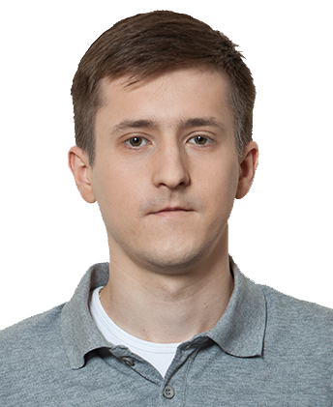
About Me
Current working in IBM
Blog: http://justcloud.pl
FB Page: http://facebook.com/justcloudpl
Group leader:
Microsoft Azure User Group Poland
http://azureug.org
Getting involve Azure solutions

Slide 5
Files, links, presentation
http://maugp.justcloud.pl

Slide 6
Subskrypcje w AZURE

Slide 7
Azure Resource Manager
You can deploy, update or delete all of the resources for your solution in a single, coordinated operation. You use a template for deployment and that template can work for different environments such as testing, staging and production. Resource Manager provides security, auditing, and tagging features to help you manage your resources after deployment.
https://azure.microsoft.com/en-us/documentation/articles/resource-group-overview/

Slide 8
Example: Active Directory HA in Azure
https://github.com/Azure/azure-quickstart-templates/tree/master/active-directory-new-domain-ha-2-dc
Two servers AD, availability set, load balancer, public IP, vnet, storage
Run time template: about 20 min
Installation AD through DSC
Other examples:
Chef template – ubuntu VM
HDInsight with DataLake
SharePoint Farm (9 VM)

Slide 9
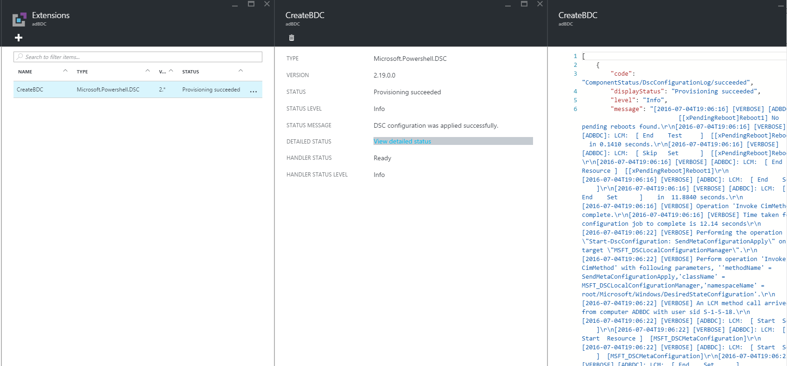
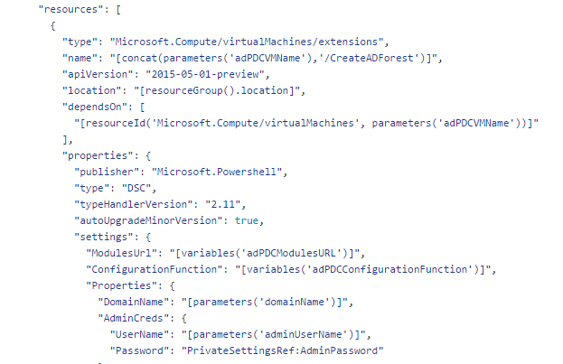
.json

Slide 10
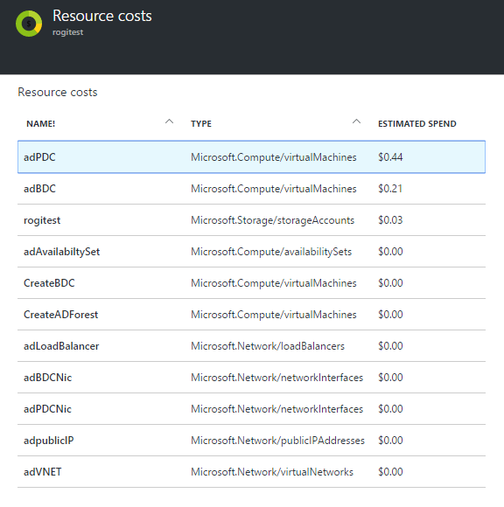

Slide 11
Template add-ons
In your Template you can use scripts:
DSC
Ready-made scripts: https://gallery.technet.microsoft.com/scriptcenter/DSC-Resource-Kit-All-c449312d
PowerShell
Create own solutions e.g copy file, create users, install app, etc.
.json
In json you can use your image

Slide 12
Template
Create enviorment or system in Azure
Configure - system
Run Sysprep
Run command in PowerShell ARM – to create template in Azure
Save VM - „Template”

Slide 13
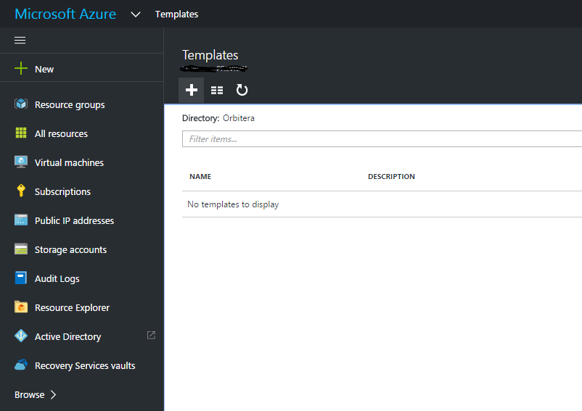

Slide 14
Summary
More time to drink cafe
Well prepared script can be use multiple times
Saving time and money
Improve skills in scripting PowerShell or DSC

Slide 15
Dziękuję za uwagę!
Questions?
Piotr Rogala
Partnerzy

